Slide 1
Part 1 Personality Traits and Attributes
Learning Objective: Analyse personality traits needed for tech jobs
Key words: Characteristics, traits, attributes

Slide 2
Starter
Activity
Activity
Think about the following questions
What kind of people do IT jobs?
Where might they work?
What sort of companies or industries would they work in?
Discuss what you think with the rest of the class.

Slide 3
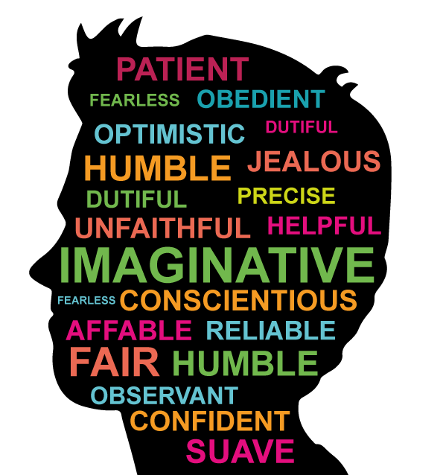
What is an attribute or trait?
This is a quality or characteristic that belongs to someone and makes up their personality.
Character traits are often shown with descriptive adjectives, like patient, unfaithful, or jealous.

Slide 4
Personality Traits and Attributes
Detailed
Likes to analyse data
Creative/innovative
Variety-seeking
Achievement-oriented
Talkative
Socially confident
Structured, methodical
Perfectionist
Likes to analyse people
Optimistic/positive
Unstructured, spontaneous
Activity
Which of these attributes and personality traits would suit someone in a Tech Job?
Discuss with the person next to you.
Do you both agree?
Feedback to class.

Slide 5

Task Job adverts
Activity
Extension activity
You have been given a job advert.
In pairs discuss what you think the job title is and what type of company the job is for.
What would you need to do to be employed in this job?
What skills/attributes would you need?

Slide 6
Summary
The point to realise here is that yes, certain jobs suit certain people more than others – but often our assumptions about what those jobs might be for us, can be limiting. It’s worth exploring different jobs within a career and seeing what appeals to you.
Also our assumptions about what jobs exist in different career choices can be very limited. We may not have expected to see jobs in fashion advertised as a tech career. It’s worth looking into career options and the jobs available to see what options there are for you.
Activity
Write down one personality trait that you have that would help you get a tech career.

